Slide 1
Structure of Real-world Networks – III
MA 653: Network Science
Instructor: Ashok Singh Sairam
ashok@iitg.ac.in

Slide 2
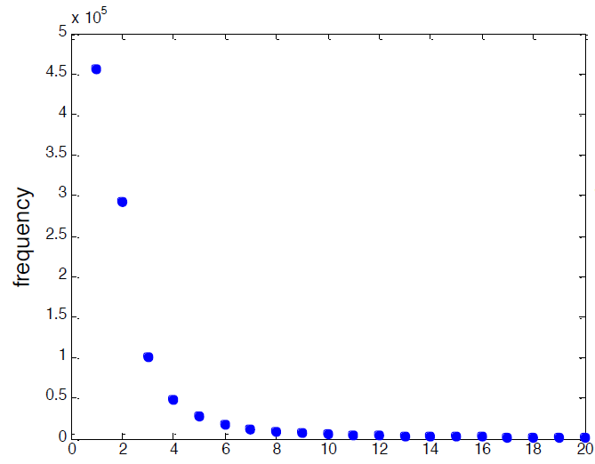
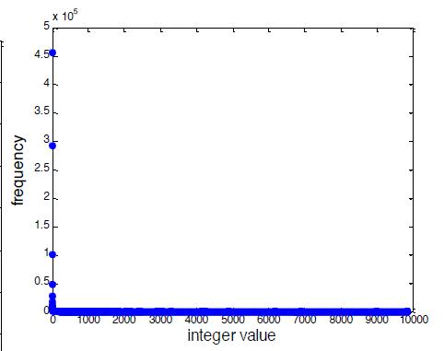
Linear scale plot
First few bins Whole range

Slide 3

log log plot

Slide 4
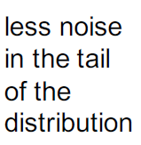
logarithmic binning
bin data into exponentially wider bins - 1, 2, 4, 8, 16, .. or 10, 100, 1000
Dis: smoothes out data but also losses information

Slide 5
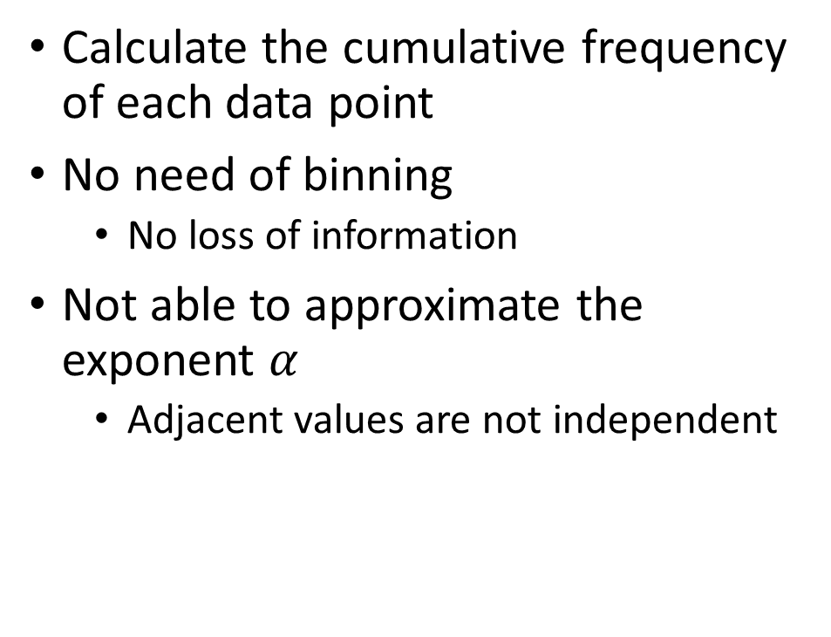
Cumulative binning
Calculate the cumulative frequency of each data point
No need of binning
No loss of information
Not able to approximate the exponent $α$
Adjacent values are not independent

Slide 6
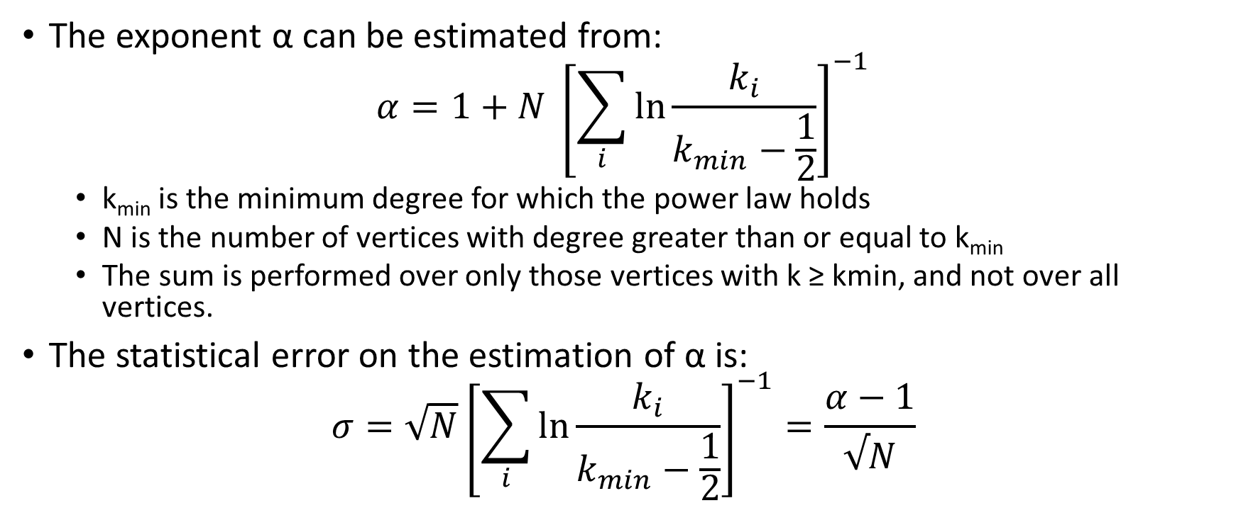
Power law exponent
The exponent α can be estimated from:
$$α=1+N {\left[\sum_{i}{\ln{\frac{k_{i}}{k_{min}−\frac{1}{2}}}}\right]}^{−1}$$
k_{min} is the minimum degree for which the power law holds
N is the number of vertices with degree greater than or equal to k_{min}
The sum is performed over only those vertices with k ≥ kmin, and not over all vertices.
The statistical error on the estimation of α is:
$$σ=\sqrt{N}{\left[\sum_{i}{\ln{\frac{k_{i}}{k_{min}−\frac{1}{2}}}}\right]}^{−1}=\frac{α−1}{√N}$$

Slide 7
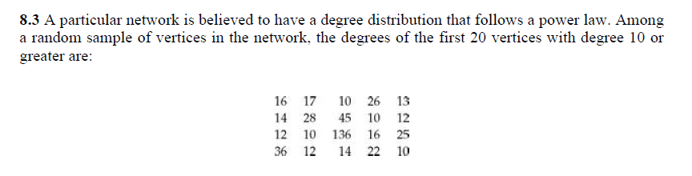
Exercise
Estimate the exponent α of the power law and the error on that estimate using Eqs. (8.6) and (8.7)
Ans => alpha = 2.530955, error = 0.34233211

Slide 8
Recap
Detecting power-law
log-log straight line
Binning
Logarithmic binning
CDF
Properties of power law
Normalization
Moments

Slide 9
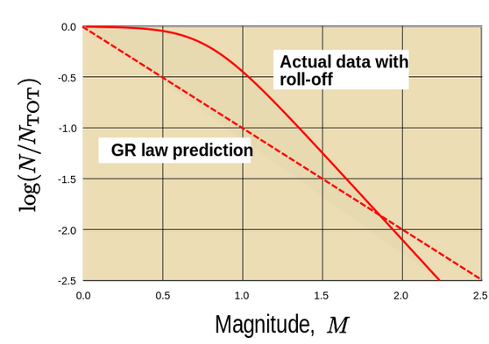
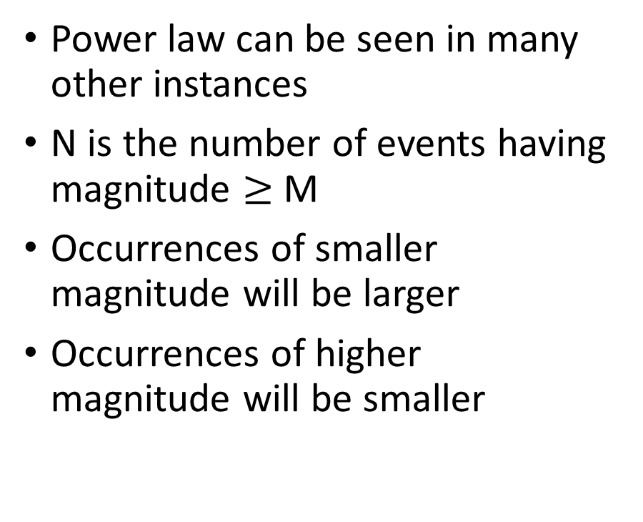
Earthquakes and power-law
Power law can be seen in many other instances
N is the number of events having magnitude $≥$ M
Occurrences of smaller magnitude will be larger
Occurrences of higher magnitude will be smaller
Courtesy: Wikipedia

Slide 10
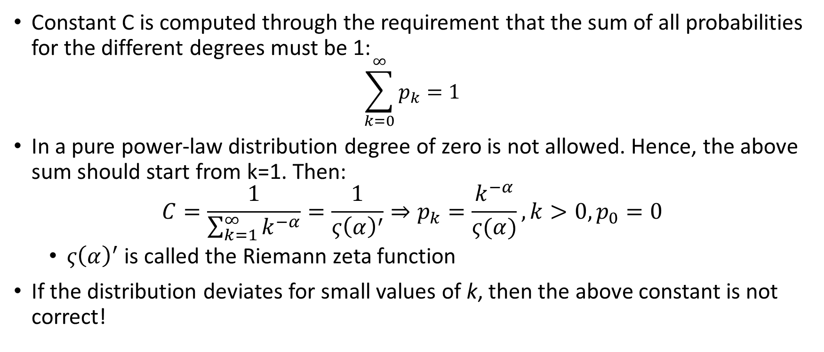
Normalization (1)
Constant C is computed through the requirement that the sum of all probabilities for the different degrees must be 1:
$$\sum_{k=0}^{∞}{p_{k}=1}$$
In a pure power-law distribution degree of zero is not allowed. Hence, the above sum should start from k=1. Then:
$$C=\frac{1}{\sum_{k=1}^{∞}{k^{−α}}}=\frac{1}{ς{\left(α\right)}^{′}}⇒p_{k}=\frac{k^{−α}}{ς(α)},k>0,p_{0}=0$$
$ς{\left(α\right)}^{′}$ is called the Riemann zeta function
If the distribution deviates for small values of k, then the above constant is not correct!

Slide 11
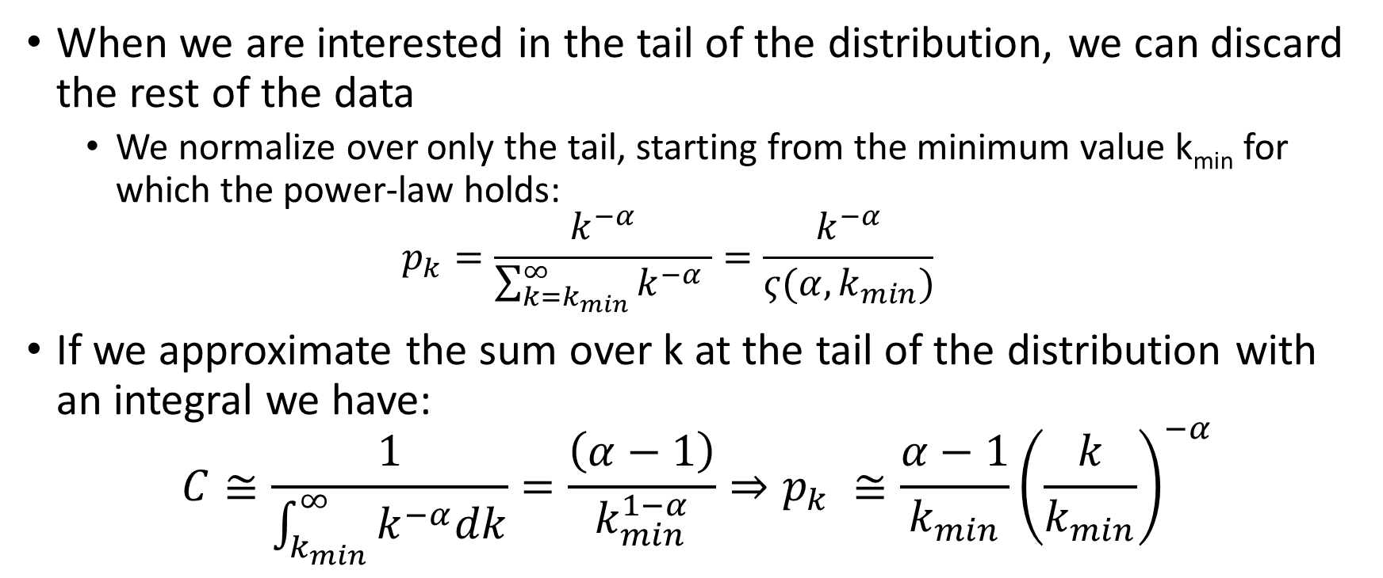
Normalization (2)
When we are interested in the tail of the distribution, we can discard the rest of the data
We normalize over only the tail, starting from the minimum value k_{min} for which the power-law holds:
$$p_{k}=\frac{k^{−α}}{\sum_{k=k_{min}}^{∞}{k^{−α}} }=\frac{k^{−α}}{ς(α,k_{min})}$$
If we approximate the sum over k at the tail of the distribution with an integral we have:
$$C≅\frac{1}{\int_{k_{min}}^{∞}{k^{−α}dk}}=\frac{\left(α−1\right)}{k_{min}^{1−α}}⇒p_{k} ≅\frac{α−1}{k_{min}}{\left(\frac{k}{k_{min}}\right)}^{−α}$$
Incomplete
zeta function

Slide 12
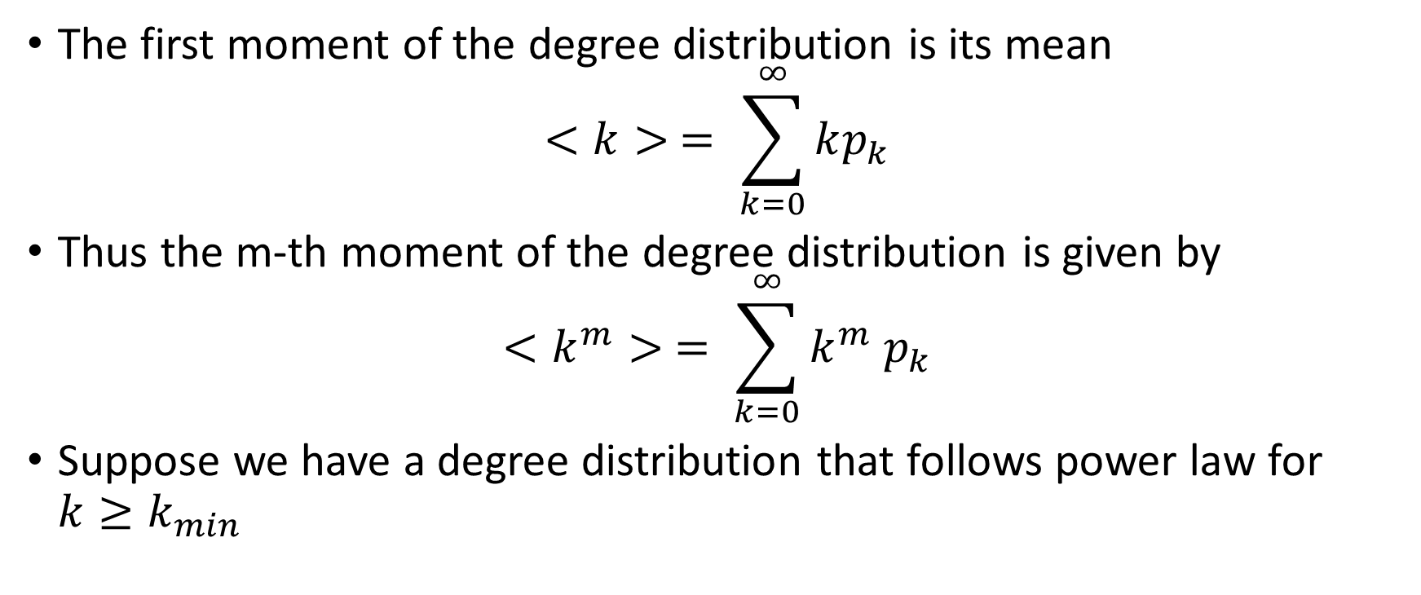
Moments
The first moment of the degree distribution is its mean
$$<k> = \sum_{k=0}^{∞}{kp_{k}}$$
Thus the m-th moment of the degree distribution is given by
$$<k^{m}> = \sum_{k=0}^{∞}{k^{m}{ p}_{k}}$$
Suppose we have a degree distribution that follows power law for $k≥k_{min}$

Slide 13
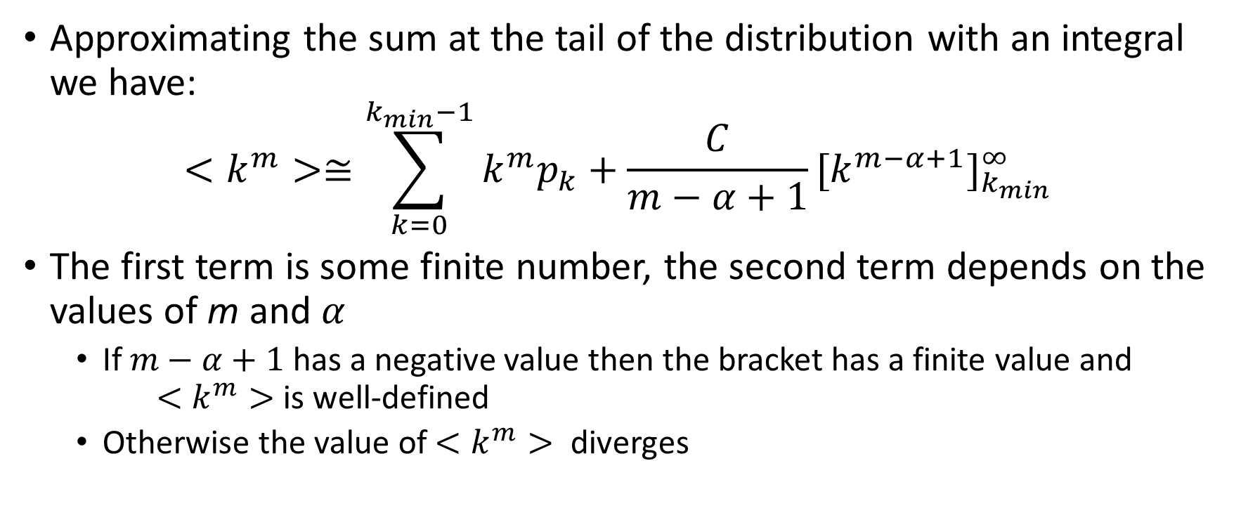
Moments (2)
Approximating the sum at the tail of the distribution with an integral we have:
$$<k^{m}>≅\sum_{k=0}^{k_{min}−1}{k^{m}p_{k}+\frac{C}{m−α+1}{[k^{m−α+1}]}_{k_{min}}^{∞}}$$
The first term is some finite number, the second term depends on the values of m and $α$
If $m−α+1$ has a negative value then the bracket has a finite value and $<k^{m}>$ is well-defined
Otherwise the value of $<k^{m}>$ diverges

Slide 14
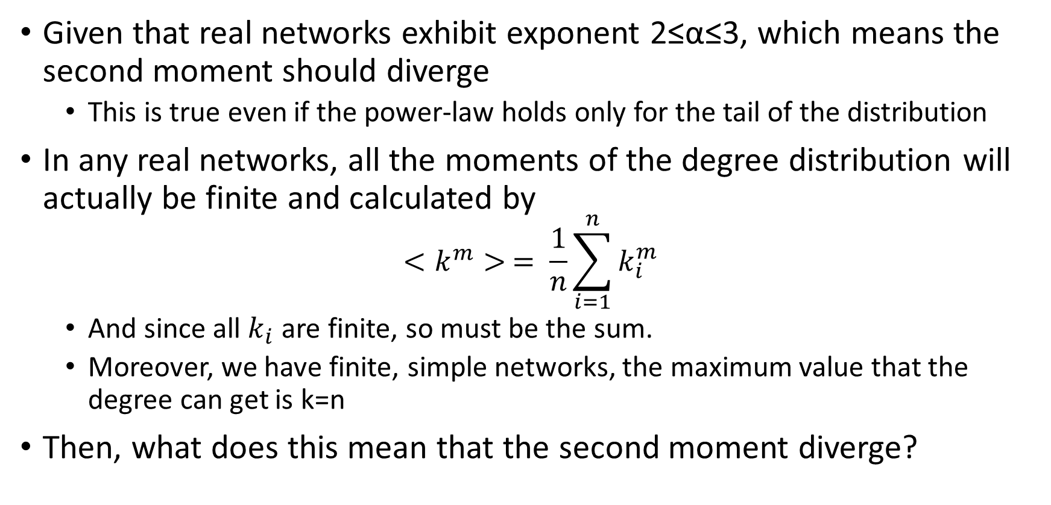
Moments (3)
Given that real networks exhibit exponent 2≤α≤3, which means the second moment should diverge
This is true even if the power-law holds only for the tail of the distribution
In any real networks, all the moments of the degree distribution will actually be finite and calculated by
$$<k^{m}> = \frac{1}{n}\sum_{i=1}^{n}{k_{i}^{m}}$$
And since all $k_{i}$ are finite, so must be the sum.
Moreover, we have finite, simple networks, the maximum value that the degree can get is k=n
Then, what does this mean that the second moment diverge?

Slide 15

Moments (3)
We say that the m-th moment diverge, if its value is arbitrarily large when n $→∞$
Even for finite-sized networks, the value of the moments while not infinite can be quite large
For Internet data, $<k^{2}> ≥1159$, which can be treated as infinite for many purposes

Slide 16
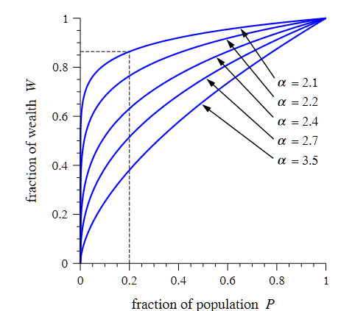
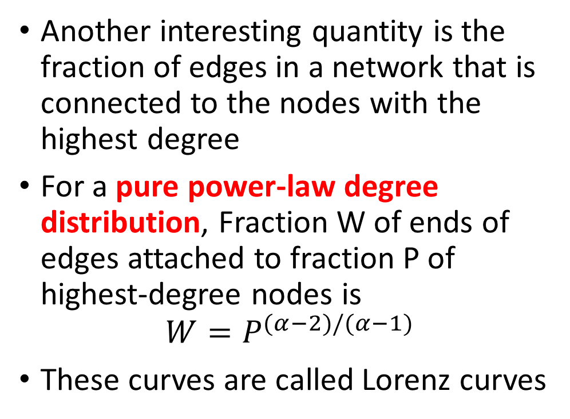
Top-heavy distributions
As the figure shows, the curves are concave downward for all values of α, and for values only a little above 2 they have a very fast initial increase, meaning that a large fraction of the edges are connected to a small fraction of the highest degree nodes.
Another interesting quantity is the fraction of edges in a network that is connected to the nodes with the highest degree
For a pure power-law degree distribution, Fraction W of ends of edges attached to fraction P of highest-degree nodes is
$$W=P^{(α−2)/(α−1)}$$
These curves are called Lorenz curves
Fraction of ends of edges W
Fraction of nodes P

Slide 17
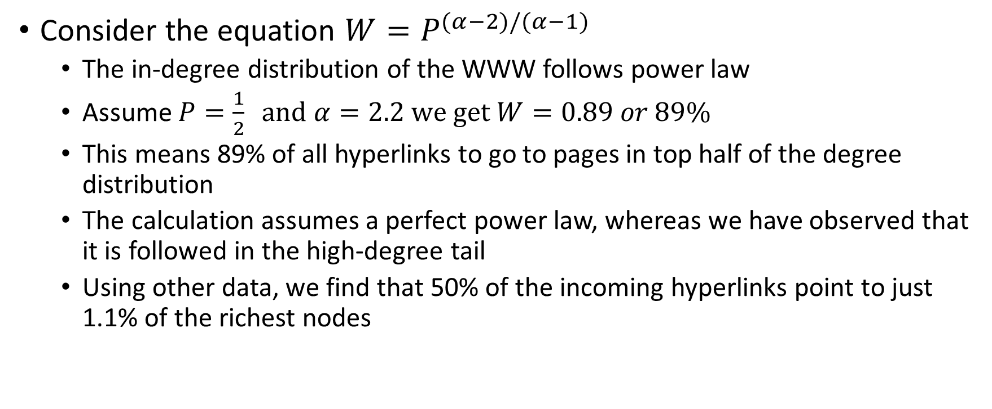
Ex: Top heavy distributions
Consider the equation $W=P^{(α−2)/(α−1)}$
The in-degree distribution of the WWW follows power law
Assume $P=\frac{1}{2} and α=2.2 we get W=0.89 or 89\%$
This means 89% of all hyperlinks to go to pages in top half of the degree distribution
The calculation assumes a perfect power law, whereas we have observed that it is followed in the high-degree tail
Using other data, we find that 50% of the incoming hyperlinks point to just 1.1% of the richest nodes

Slide 18
Distribution of Eigenvector centrality
Eigenvector centrality can be thought of as an extended form of degree centrality
Takes into account not only how many neighbours a node has but also how important these neighbours themselves are
Given its similarity to degree centrality, it is not surprising that the distribution of eigenvector is similar to that of degree distribution
Cumulative distribution of eigenvector centralities for the nodes of the Internet (AS level), WWW and citation network exhibit power law
Some networks are right skewed but non-power law distribution

Slide 19
Distributions of betweenness centrality
Eigenvector and betweeness centrality often have a highly right-skewed distribution
Not necessarily power law though
Internet

Slide 20
Distributions of closeness centrality
Closeness centrality does not exhibit skewed distribution
Closeness centrality takes values in a small range (1 to logn) and hence there cannot be long tail
Internet

Slide 21
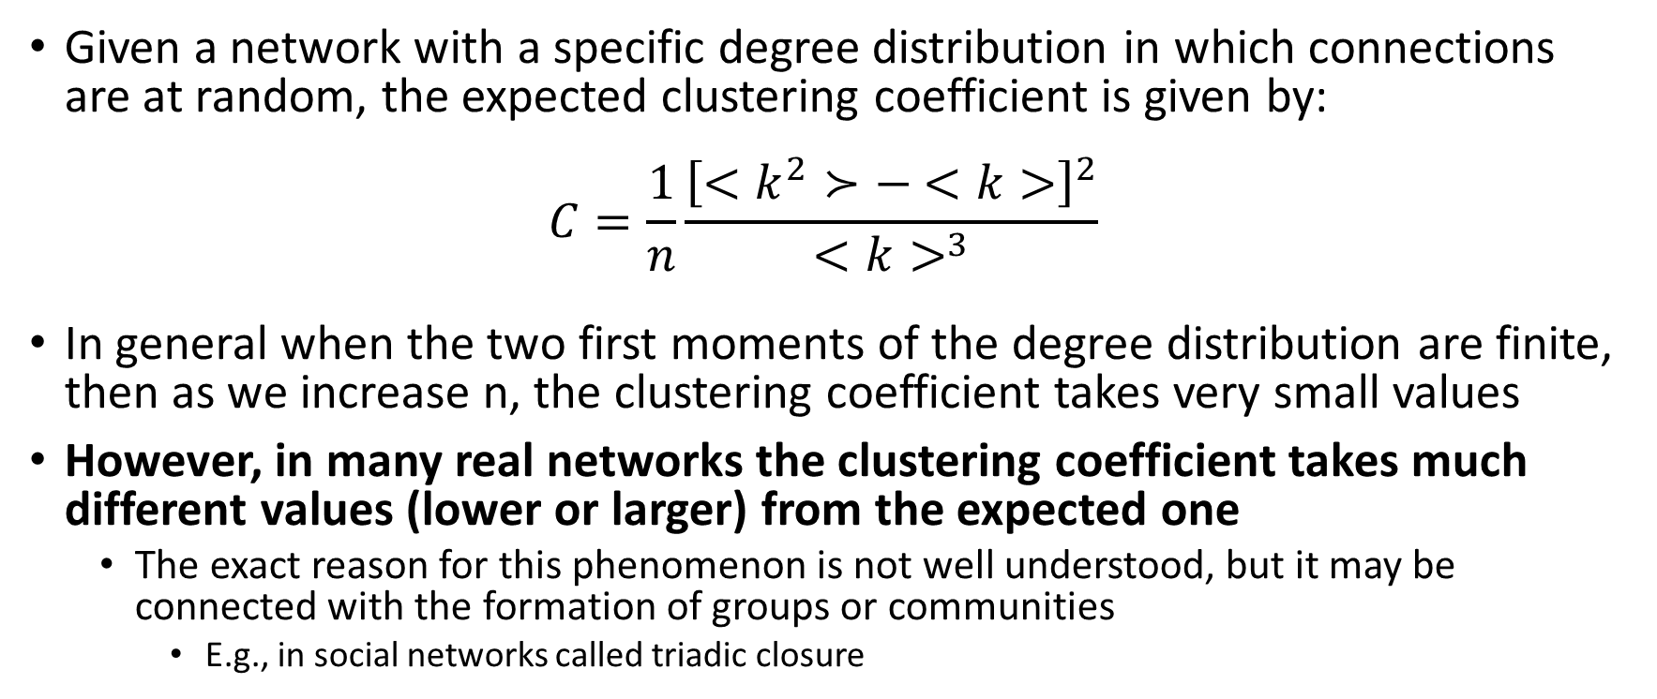
Clustering coefficients
Given a network with a specific degree distribution in which connections are at random, the expected clustering coefficient is given by:
$$C=\frac{1}{n}\frac{{\left[<k^{2}≻− <k>\right]}^{2}}{<k>^{3}}$$
In general when the two first moments of the degree distribution are finite, then as we increase n, the clustering coefficient takes very small values
However, in many real networks the clustering coefficient takes much different values (lower or larger) from the expected one
The exact reason for this phenomenon is not well understood, but it may be connected with the formation of groups or communities
E.g., in social networks called triadic closure

Slide 22
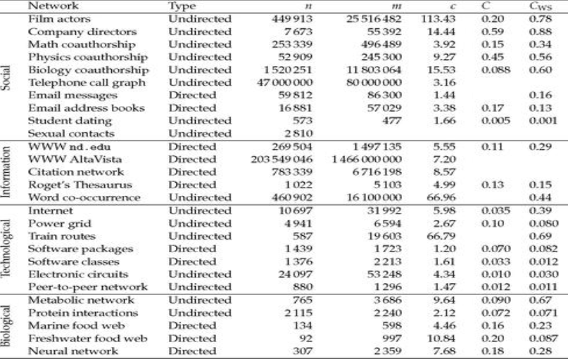
Clustering coefficients in real networks
Clustering coefficient found to have values sharply different from what one would expect on the basis of chance
Notes:
Clustering coefficient quantifies the density of triangles in a network
Most of the values are on the order of tens of percent – there is typically a probability between 10% to 60% that two neighbours of a node will be themselves neighbours

Slide 23
Local clustering coefficient
If we calculate the clustering coefficient of all vertices of a network an interesting pattern occurs
On average, vertices of higher degree exhibit lower local clustering
Internet

Slide 24
Assortative mixing by degree
In general the absolute values of the assortativity coefficient r are not large
Technological networks tend to have negative r, while social networks tend to have positive r
In general, for simple networks, due to the limited number of possible edges between high degree nodes, one should expect (in the absence of other biases) disassortative mixing
Social networks?
There might be other biases in place that cause a slight assortative mixing

Slide 25
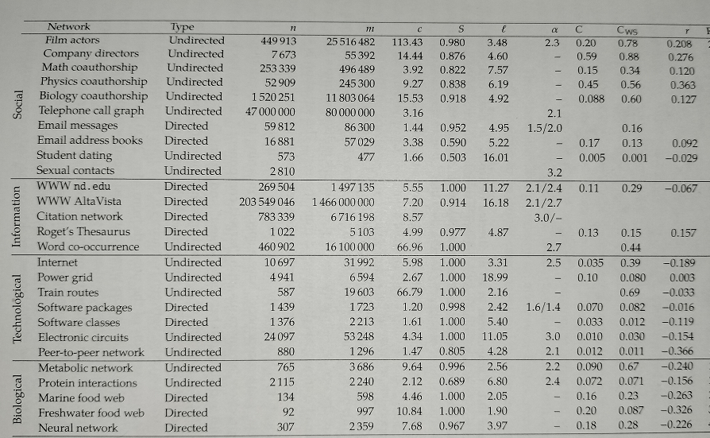
Statistics for real networks:assortative

Slide 26
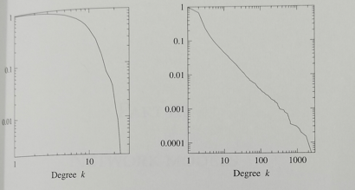

Review
Ex 10.4: (a) Which of these networks is scale-free?
(b) If there are m edges in the scale-free network, there are 2m ends of edges. Approximately what fraction of the highest-degree nodes have a half of all the edge-ends? [$α=2.1$]
Ans Hint: (W is given,
find P)
Ans => 0.0004

